Slide 1


序列标注(EMNLP2018)
陈海斌
Lab of Machine Learning and Data Mining
South China University of Technology

Slide 2
Outline
Part1 手工特征的必要性与“特征引入”的系统构建形式
Evaluating the Utility of Hand-crafted Features in Sequence Labelling
(2018 EMNLP)
Part2 句子隐层语义块的构建
Semantic-Unit-Based Dilated Convolution for Multi-Label Text Classification
(2018 EMNLP)

Slide 3
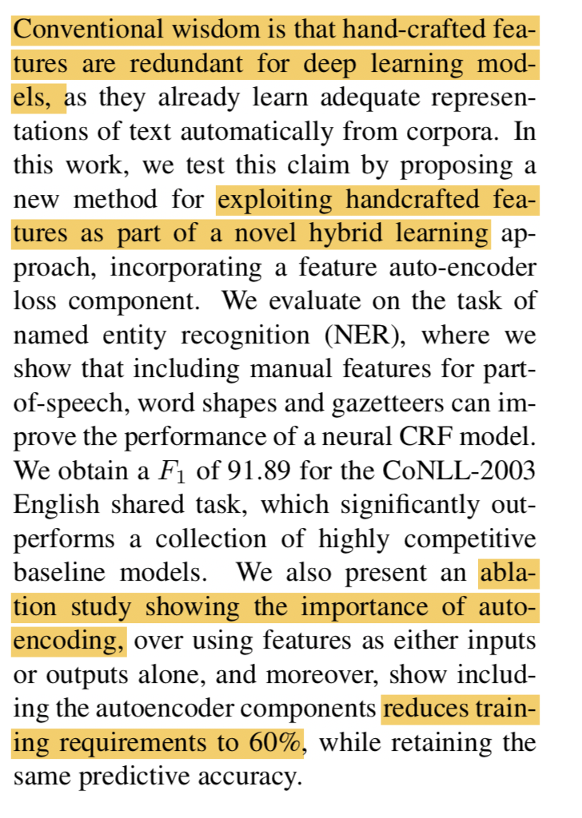
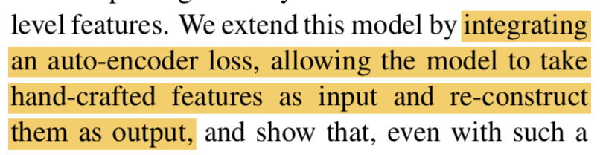
Part1 Evaluating the Utility of Hand-crafted Features in Sequence Labelling (2018 EMNLP)
Introduction:
传统手工特征被认为是多余的
构建手工特征系统减少训练语料需求
手工特征做为深度学习模型的补充
Motivation:
证明引入手工特征的优势
用自编码器构建手工特征系统最优
减少对语料的依赖

Slide 4
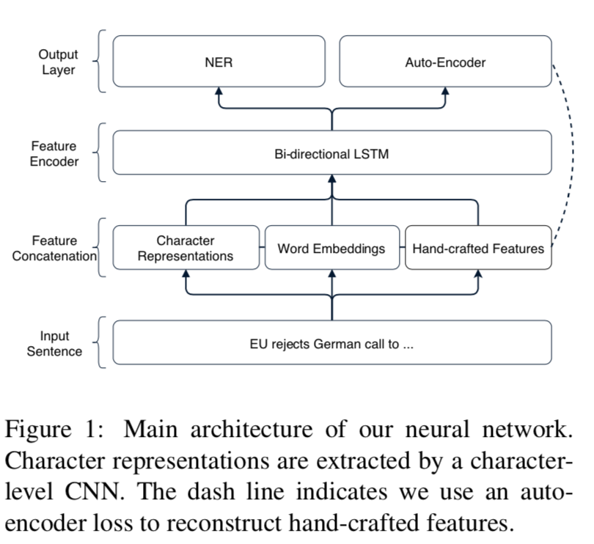
Part1 Evaluating the Utility of Hand-crafted Features in Sequence Labelling (2018 EMNLP)
基础模型Char-CNN+BiLSTM+CRF

Slide 5
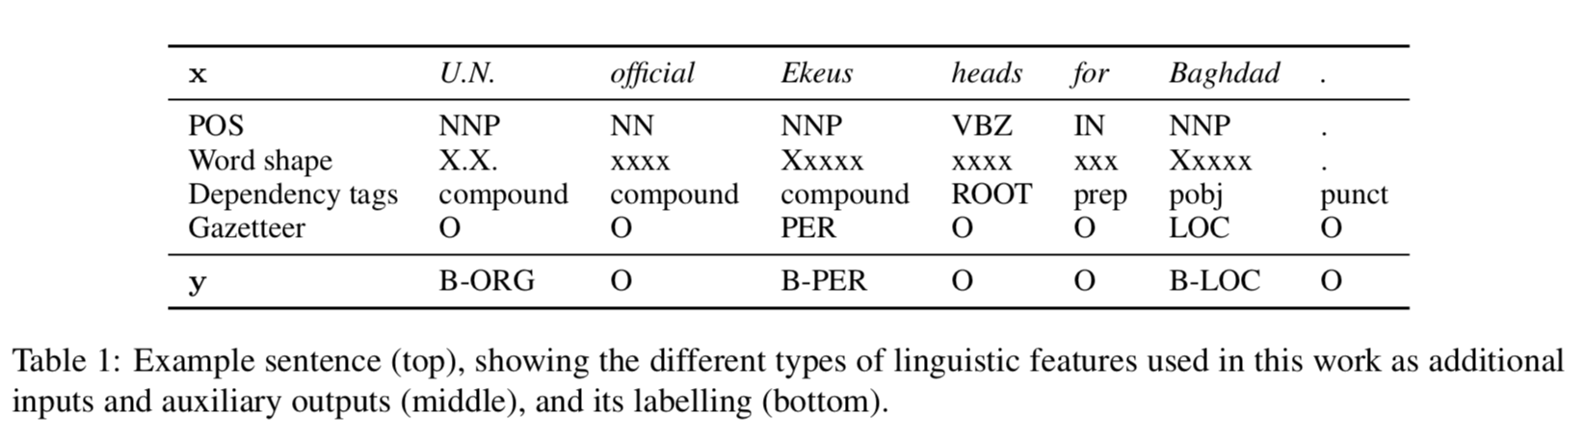
Part1 Evaluating the Utility of Hand-crafted Features in Sequence Labelling (2018 EMNLP)
NER中的特征工程
Each category is converted into a one-hot sparse feature vector f and then concatenated to form a multi-hot vector fi = [f POS;f shape;f gazetteer] for word i
incoming dependency edge to each word not worked

Slide 6
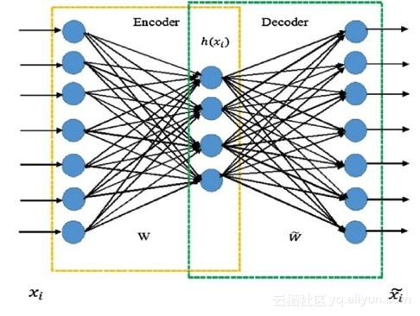
Part1 Evaluating the Utility of Hand-crafted Features in Sequence Labelling (2018 EMNLP)
自编码器：
这里：三层全连接神经网络 交叉熵

Slide 7
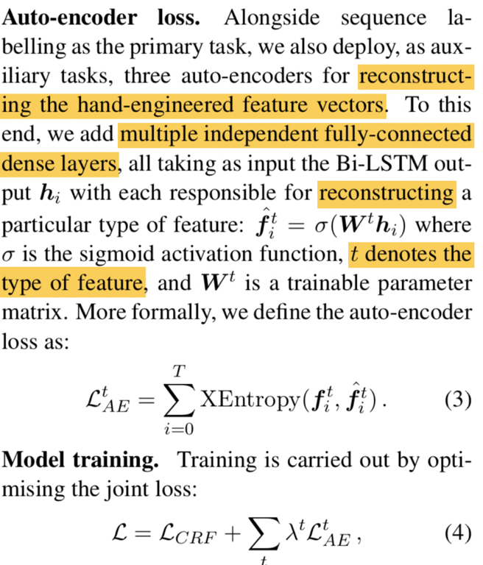
Part1 Evaluating the Utility of Hand-crafted Features in Sequence Labelling (2018 EMNLP)

Slide 8
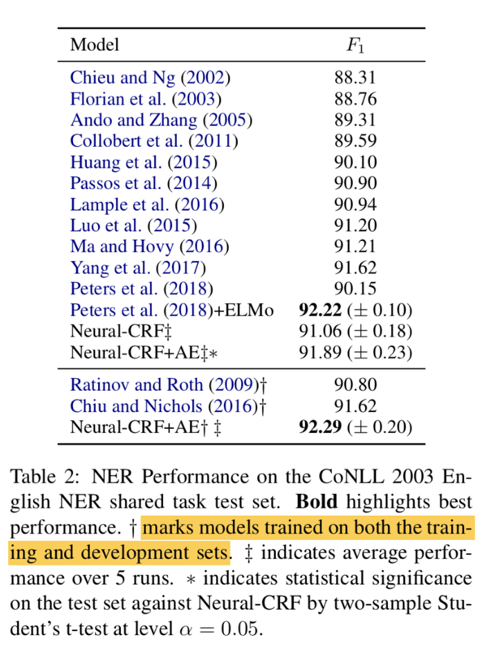
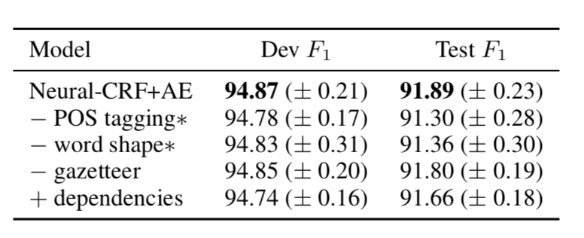
Part1 Evaluating the Utility of Hand-crafted Features in Sequence Labelling (2018 EMNLP)
Gazeteer:the noise introduced in the matching process

Slide 9
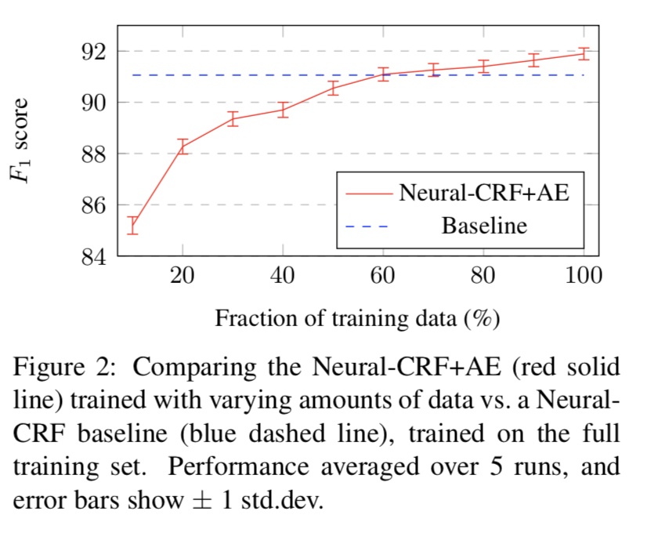
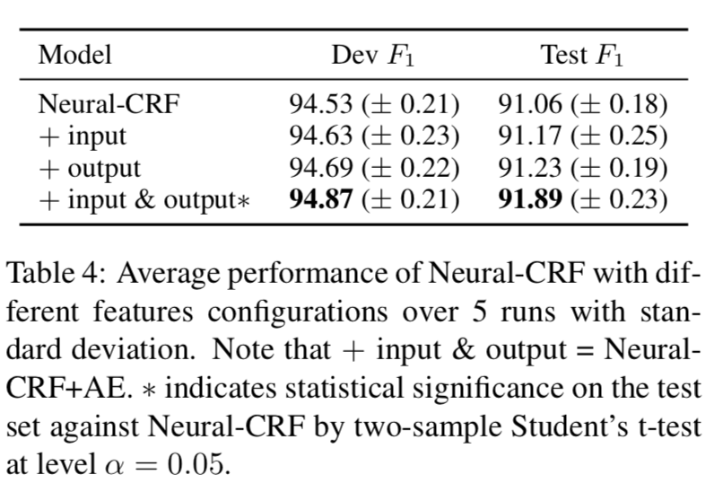
Part1 Evaluating the Utility of Hand-crafted Features in Sequence Labelling (2018 EMNLP)

Slide 10
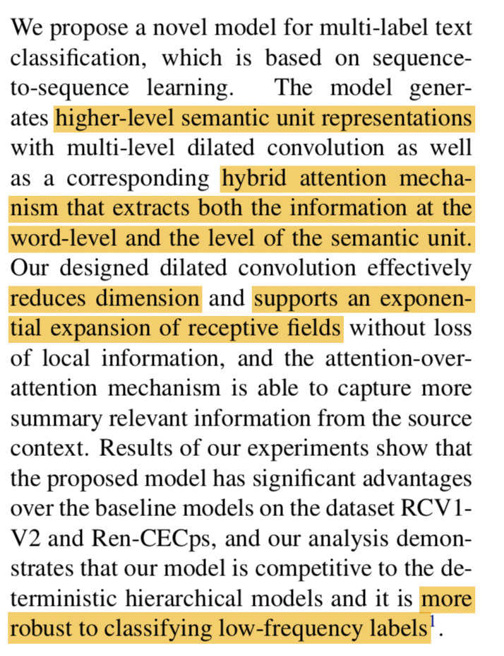
Part2 Semantic-Unit-Based Dilated Convolution for Multi-Label Text Classification (2018 EMNLP)
Introduction:
多标签文本分类 encoder-decoder捕捉了标签依赖
传统attention为词级别的权重分配，文本分类任务着重语句块/短语的语义(the salient part)
Motivation:
Attention放在语义块部分和LSTM部分
解决长时依赖
更好地提取局部语义

Slide 11
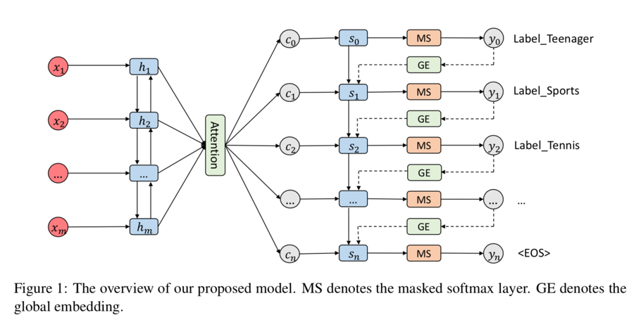
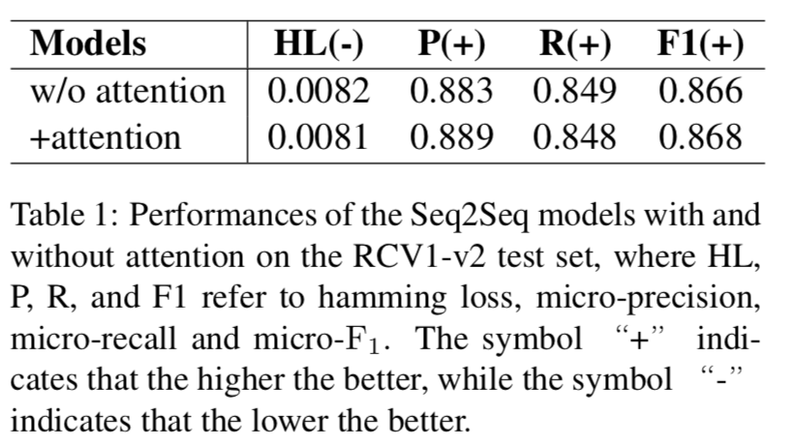
Part2 Semantic-Unit-Based Dilated Convolution for Multi-Label Text Classification (2018 EMNLP)
多标签文本分类：
seq2seq good
attention bad

Slide 12
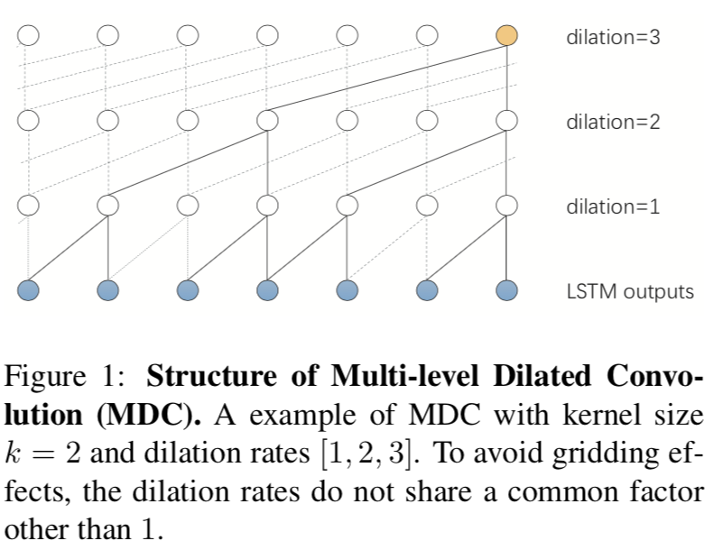
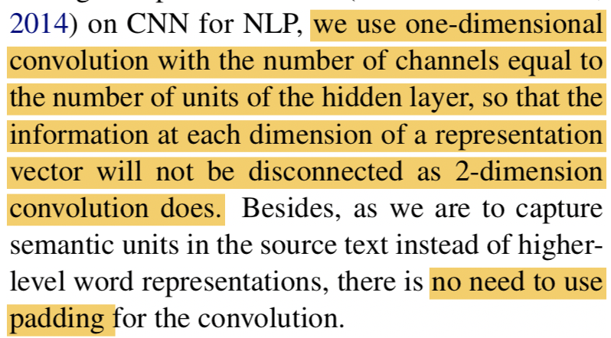
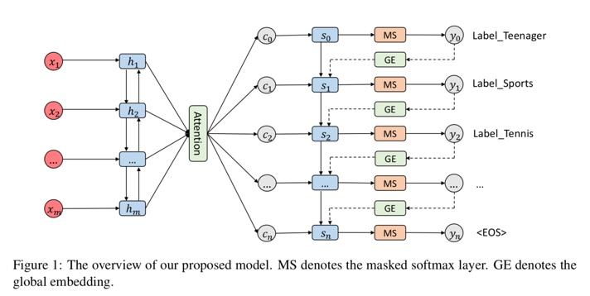
Part2 Semantic-Unit-Based Dilated Convolution for Multi-Label Text Classification (2018 EMNLP)
Multi-level Dilated Convolution ：
一维卷积CNN 通道数为隐层维数 只在width或者说height方向上进行滑窗并相乘求和
无padding -> 高层特征

Slide 13
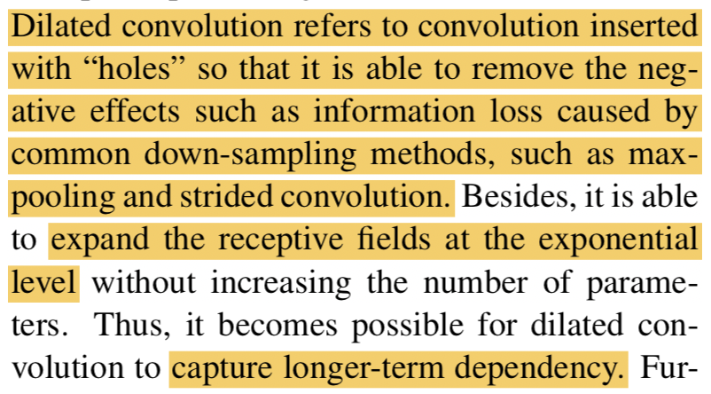
Part2 Semantic-Unit-Based Dilated Convolution for Multi-Label Text Classification (2018 EMNLP)
Multi-level Dilated Convolution ：
不像池化/跨步卷积损失信息
只是对每个隐层维度“跨时间”卷积

Slide 14
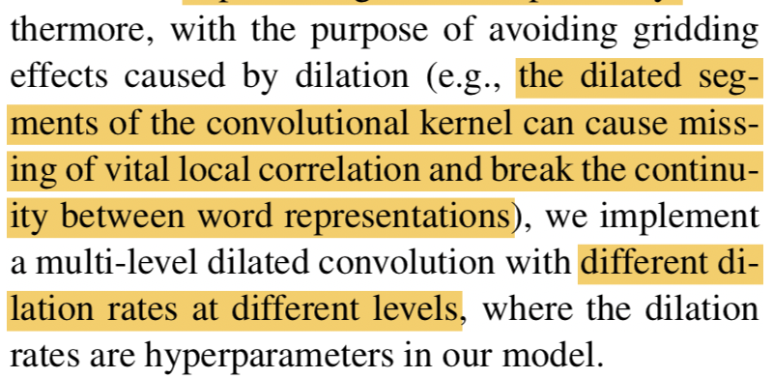
Part2 Semantic-Unit-Based Dilated Convolution for Multi-Label Text Classification (2018 EMNLP)
Multi-level Dilated Convolution ：
防止gridding effects
Dilated rate:超参
[1,2,3] or [2,5,9]

Slide 15
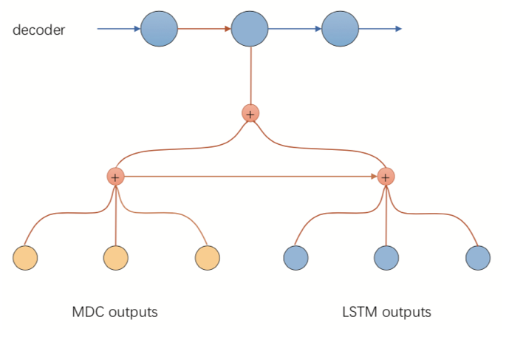
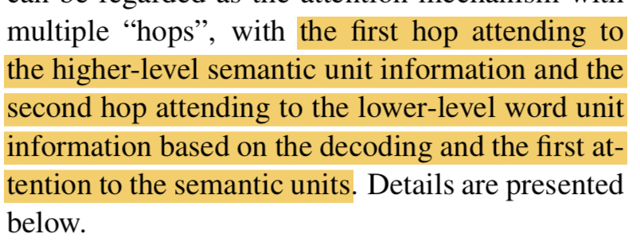
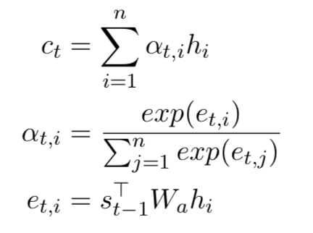
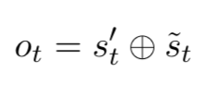
Part2 Semantic-Unit-Based Dilated Convolution for Multi-Label Text Classification (2018 EMNLP)
Hybrid Attention
1. first pays attention to the semantic unit to get s_{t}’(拼接)
2. then s_{t}’ attends to the source annotations from the LSTM encoder to get s ̃t
3.element-wise
so it can extract word-level information from the source text with the guidance of the semantic units
attention:

Slide 16
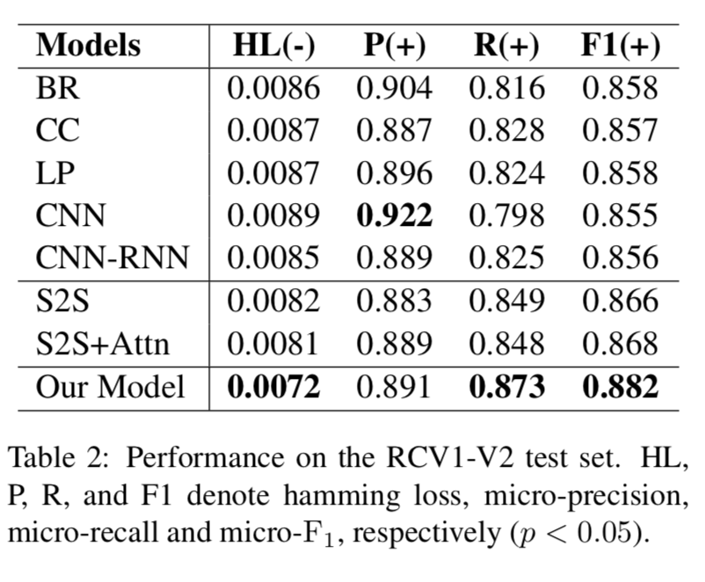
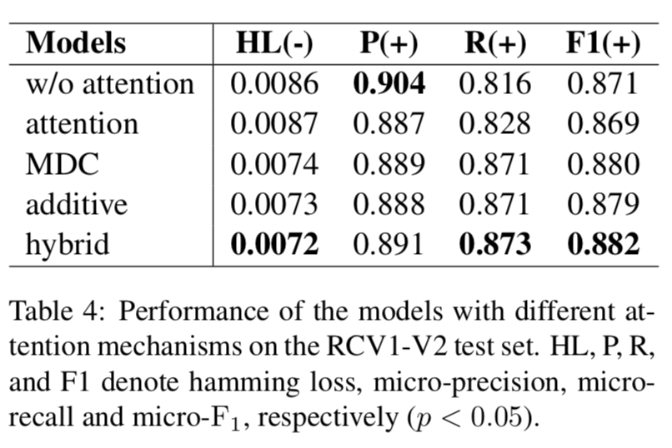
Part2 Semantic-Unit-Based Dilated Convolution for Multi-Label Text Classification (2018 EMNLP)
Results：
Additive:st attends to the semantic unit representations and the source annotations respectively, finally element-wise

Slide 17
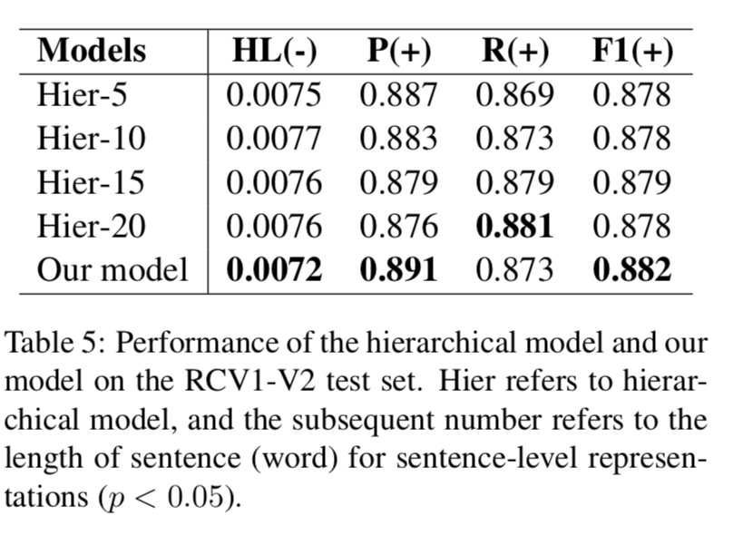
Part2 Semantic-Unit-Based Dilated Convolution for Multi-Label Text Classification (2018 EMNLP)
构建层级语义
1. learnable high-level representations can contribute more than deterministic sentence-level representations, as it can be more flexible to represent information of diverse levels
2. 参数多

Slide 18
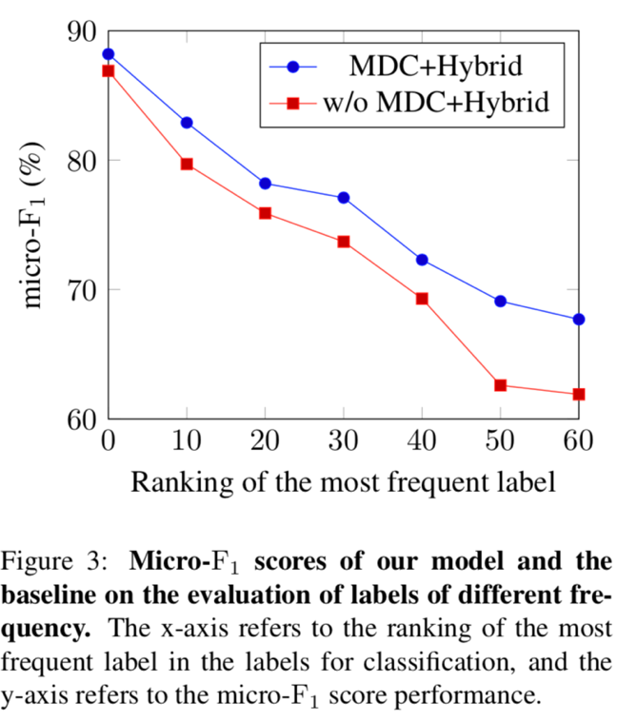
Part2 Semantic-Unit-Based Dilated Convolution for Multi-Label Text Classification (2018 EMNLP)

Slide 19


Thanks for your listening ...

